Slide 1
Generator
Discriminator
Input Z
Fake X
Real/Fake
Real X

Slide 2
Conditioner
True/False
Generator
Input Z
Fake X
Discriminator
Real/Fake
Real X

Slide 3
Conditioner
X_real
X_fake
True/False
G
C (label)
Z (noise)
Real/Fake
CGAN
G

Slide 4


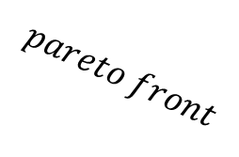
$$f_{2}$$
$$pareto front$$
$$f_{1}$$

Slide 5
Task 1
Task 2
Task 3
Specific layers
Shared layers

